Slide 1
SDPA 2021 Annual Conference

Slide 2
SDPA 2021 Annual Conference
Who is SDHDA?
Created in 1973
11-11-10. Development authority created--Independent instrumentality. There is hereby created and established a body politic and corporate with such duties and powers as are set forth in this chapter, to be known as the "South Dakota Housing Development Authority" to carry out the provisions of this chapter. The authority is hereby constituted an independent public instrumentality exercising essential public functions. Source: SL 1973, ch 180, § 3; SDCL Supp, § 28-19-10.

Slide 3
SDPA 2021 Annual Conference
Who is SDHDA?
SDHDA’s Executive Director – Lorraine Polak
Homeownership – Brent Adney
Multi-Family Development – Chas Olson
Single Family Development- Mike Harsma
Rental Housing Management – Tasha Jones
Finance & HR – Todd Hight

Slide 4
SINGLE FAMILY DEVELOPMENT DIVISION
Governor’s House Program
Affordable housing for qualified families
Inmate Training Program
Economic Development tool
Started in 1996 by then Governor Bill Janklow
Moved to Mike Durfee State Prison in 1997 and expanded to include all South Dakotans under income limits
Receives no direct state taxpayer dollars

Slide 5
SINGLE FAMILY DEVELOPMENT DIVISION
Governor’s House Program
House Price
$57,700.00 Two-Bedroom
$68,900.00 Three-Bedroom
Income Qualifications
70% of state median income for household size of two or less (currently $52,850.00)
80% of state median income for household size of three or more (currently $60,400.00)
Net Worth Qualifications
$125,000 for under age 62
$250,000 for age 62 and older

Slide 6
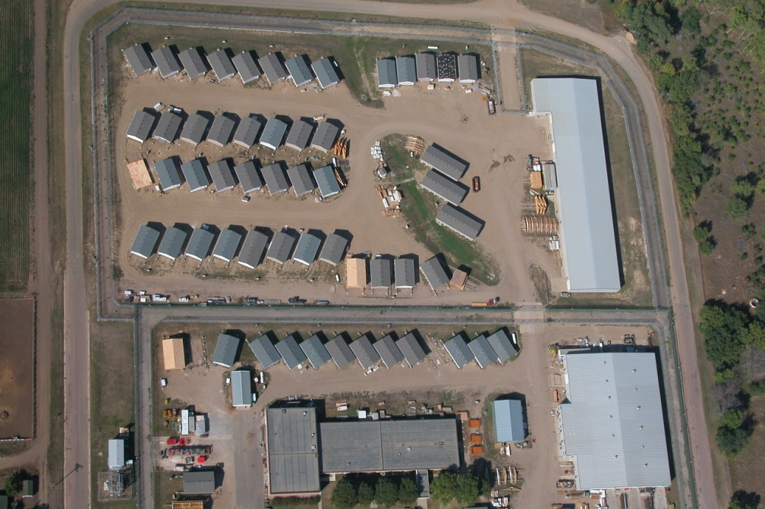
SINGLE FAMILY DEVELOPMENT DIVISION
Governor’s House Program
Sales and Production
As of 06/31/21
Sold: 3,036
Constructed: 2,758
Delivered: 2,740
One in every SD county
Currently employ approx. 165 inmates per day

Slide 7
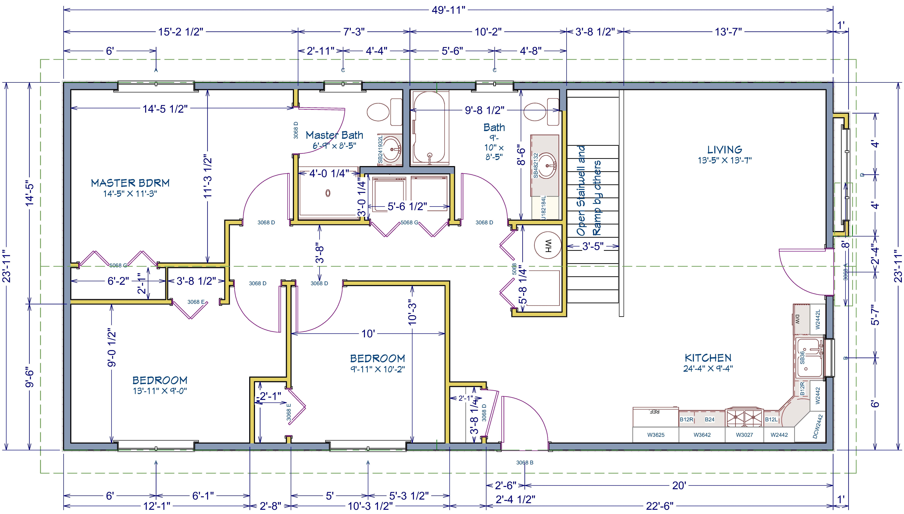
SINGLE FAMILY DEVELOPMENT DIVISION
Governor’s House Program
Three-Bedroom Two-Bath
1200 Square Feet (24’ x 50’)

Slide 8
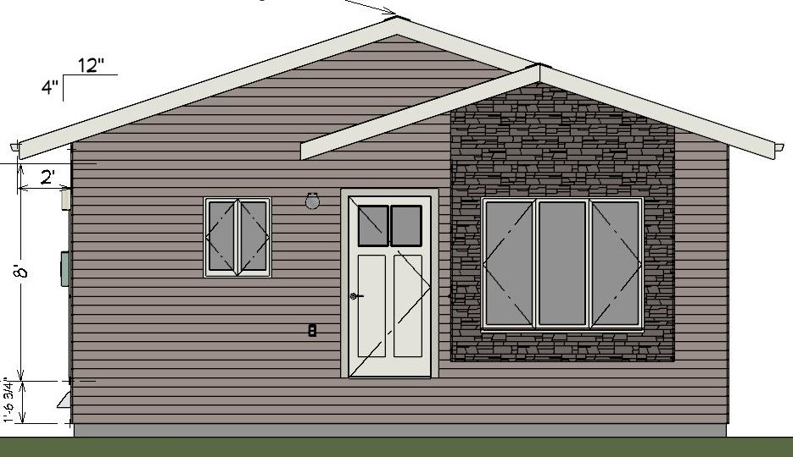
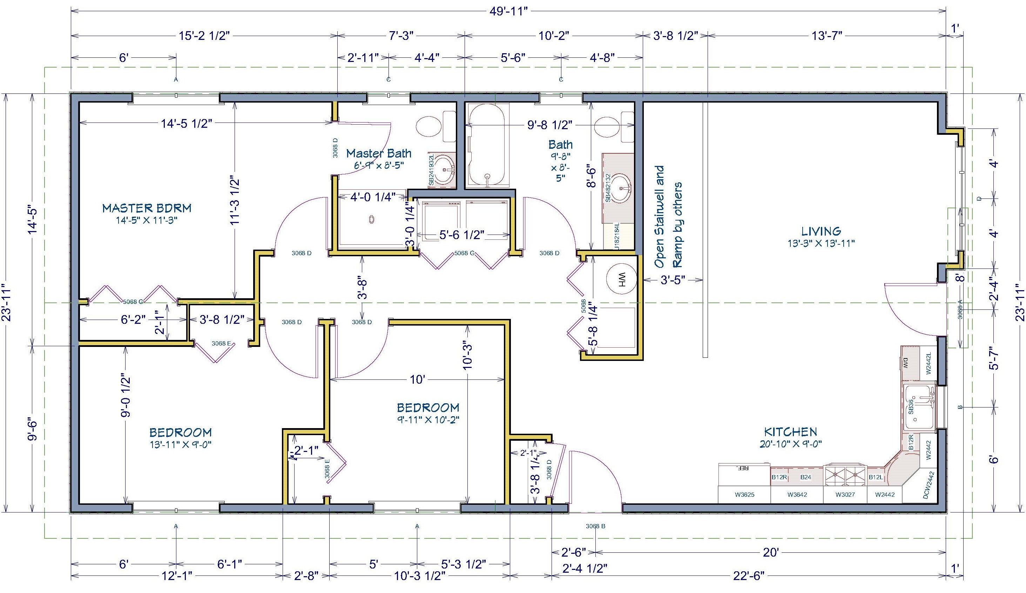
SINGLE FAMILY DEVELOPMENT DIVISION
Governor’s House Program
Three-Bedroom Narrow Lot
1200 Square Feet (24’ x 50’)

Slide 9
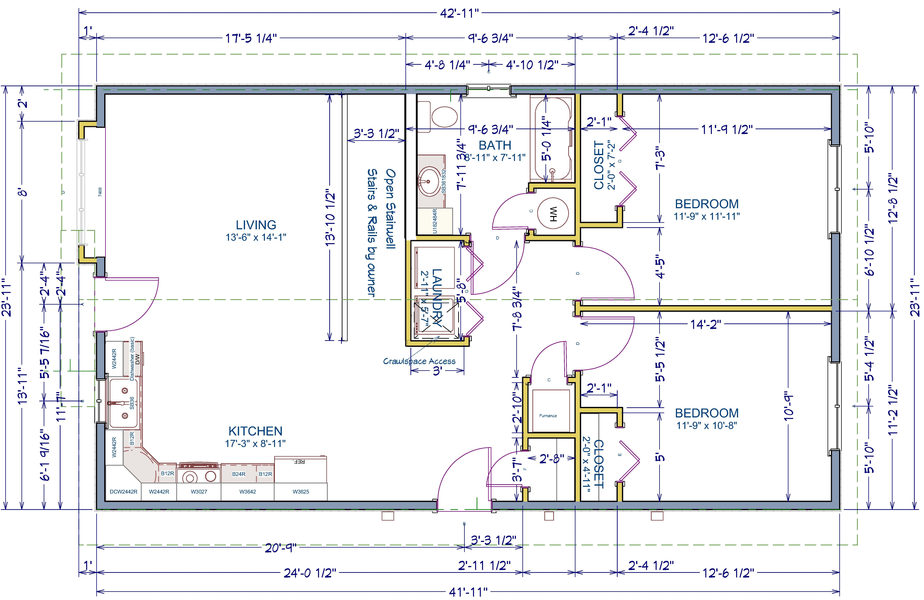
SINGLE FAMILY DEVELOPMENT DIVISION
Governor’s House Program
Two-Bedroom Narrow Lot
1008 Square Feet (24’ x 42’)

Slide 10
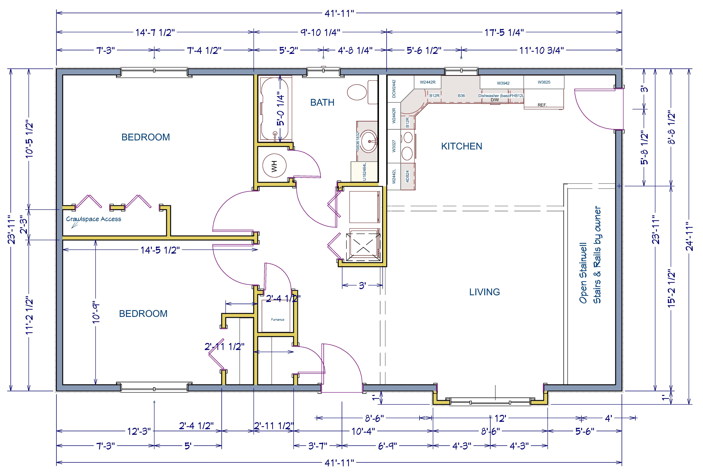
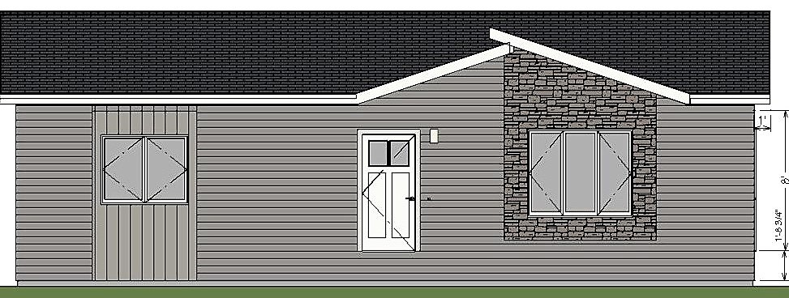
SINGLE FAMILY DEVELOPMENT DIVISION
Governor’s House Program
Two-Bedroom Layout
1008 Square Feet (24’ x 42’)

Slide 11
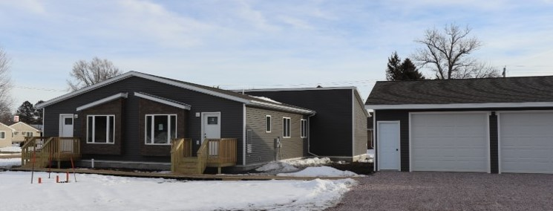
SINGLE FAMILY DEVELOPMENT DIVISION
The DakotaPlex Program

Slide 12
SINGLE FAMILY DEVELOPMENT DIVISION
The DakotaPlex Program
The Program Terms are as follow:
Must be placed within the city limits in communities of 5000 or less in population
Community must show a documented need for housing via housing study or market needs analysis
Can be purchase, owned and managed by a community, a non-profit or a for profit developer
Cannot be owner occupied but must be offered as an affordable rental

Slide 13
SINGLE FAMILY DEVELOPMENT DIVISION
The DakotaPlex Program
The Program Terms are as follow (con’t):
Purchaser can market units to any potential tenant in the community but are limited in the maximum amount of rent they can charge
In 2021 those max rents are as follows:
1-bed $1057.00
2-Bed $1189.00
3-Bed $1321.00
It must remain an affordable rental for 10 years from purchaser. Terms enforced via Declaration of Land Use Restrictive Covenants.

Slide 14
SINGLE FAMILY DEVELOPMENT DIVISION
The DakotaPlex Program
The units are designed to be mixed and matched as the community needs and lot requirements dictate.
Each “unit” is priced separately and then combined for a total purchase price
The unit purchase price is as follows:
One Bedroom Two Bedroom Three Bedroom
$61,700.00 $68,700.00 $78,700.00
The unit price includes delivery and the location site work required to tie units together but does not include sales or excise tax, or any improvements done.

Slide 15
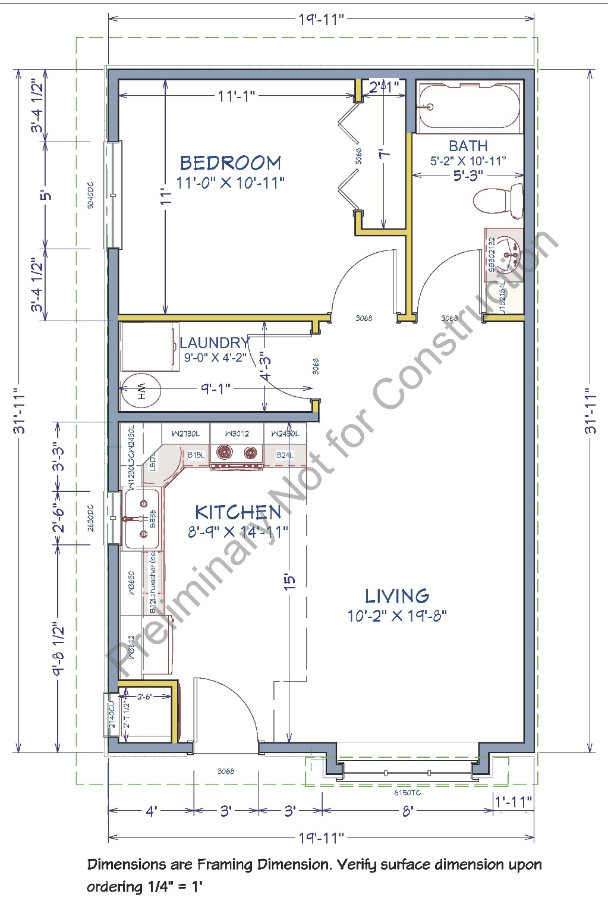
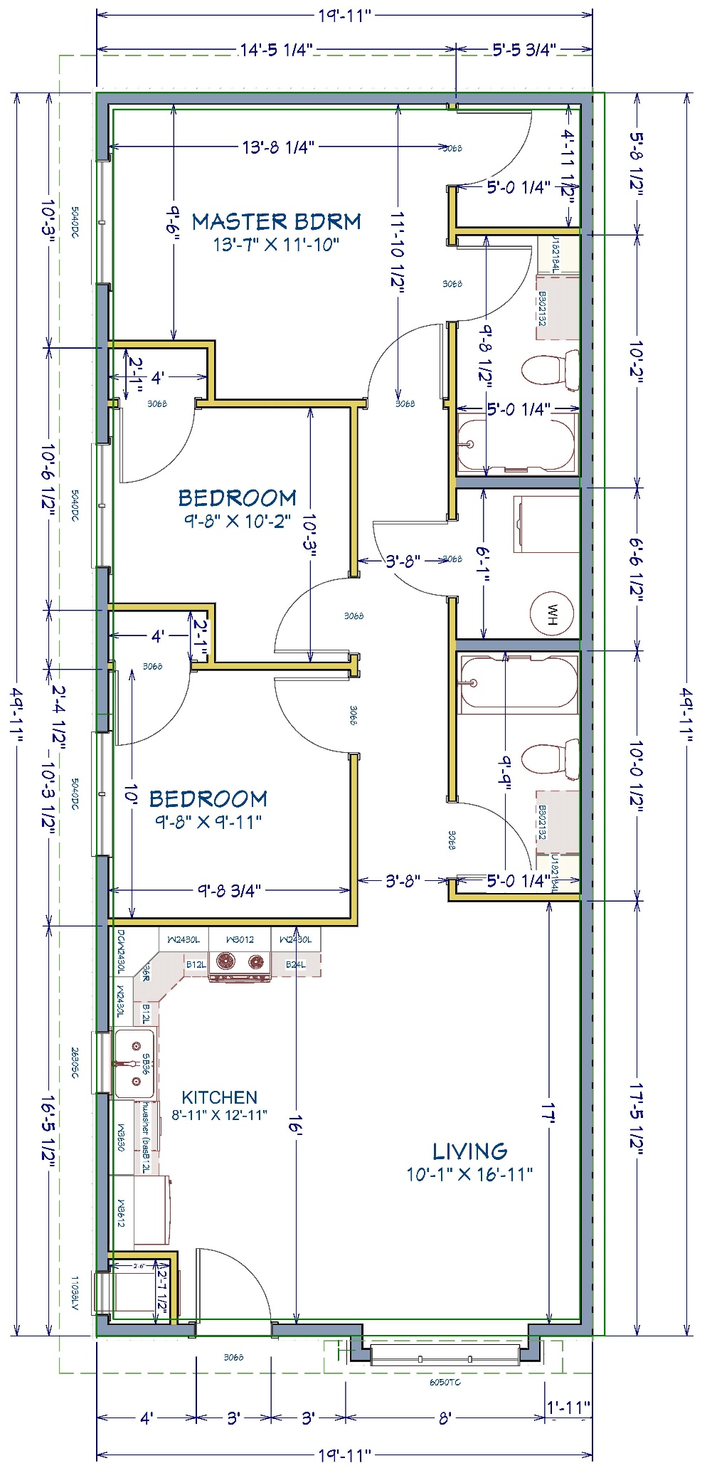
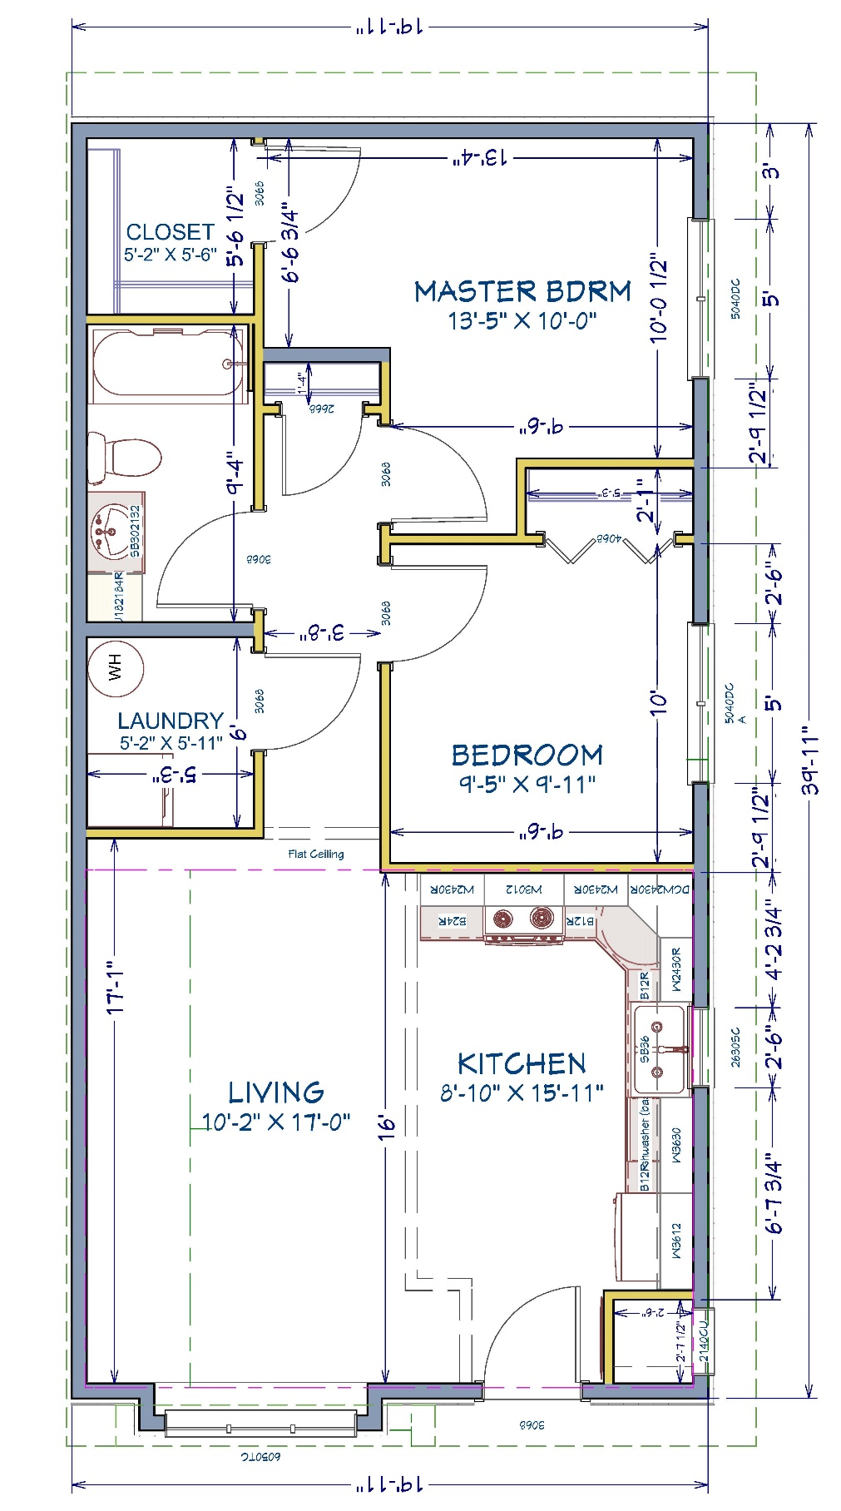
SINGLE FAMILY DEVELOPMENT DIVISION
The DakotaPlex Program
1-Bedroom
2-Bedroom
3-Bedroom

Slide 16
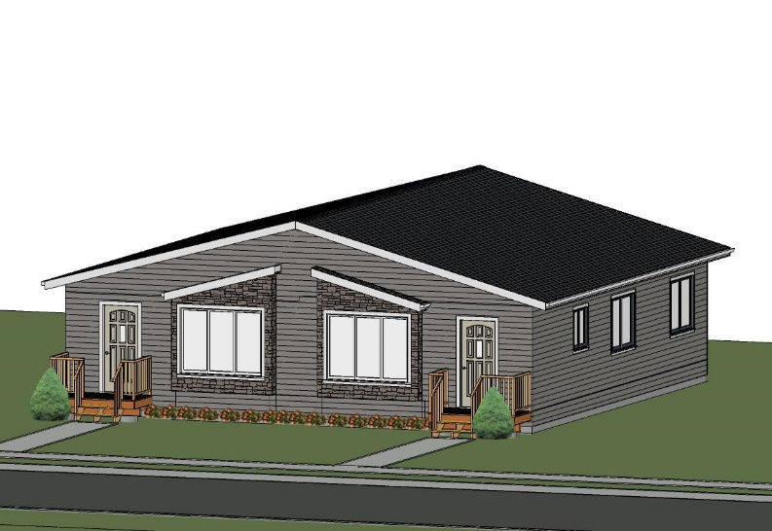
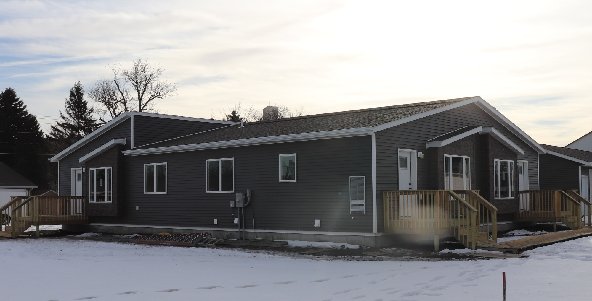
SINGLE FAMILY DEVELOPMENT DIVISION
The DakotaPlex Program
Duplex
Triplex

Slide 17
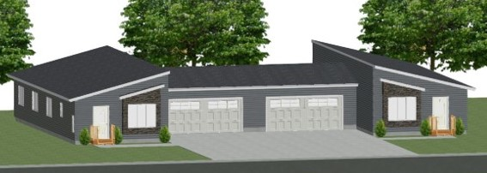
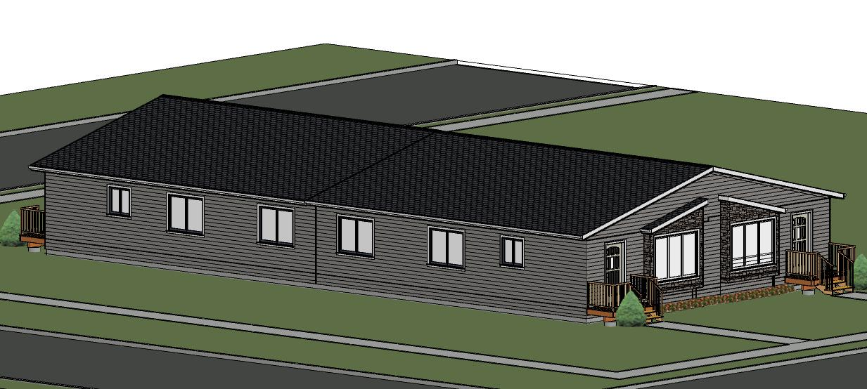
SINGLE FAMILY DEVELOPMENT DIVISION
The DakotaPlex Program
Duplex with garages
Qaudraplex

Slide 18
SINGLE FAMILY DEVELOPMENT DIVISION
Loan Guarantee Program
Near term focus on expanding and better utilizing this program
Construction Loan Guarantee Program
SDHDA will guarantee up to 50% of a total construction loan made to an individual contractor
Construction loan cannot exceed 85% of the total value of the house
SDHDA will not guarantee more than 5 housing units at a time by an individual contractor
The maximum sales price cannot exceed limits established by SDHDA
There is a 0.5% guarantee fee charged by SDHDA
Guarantee expires 1-year from closing of construction loan

Slide 19
SINGLE FAMILY DEVELOPMENT DIVISION
Loan Guarantee Program
Housing Development Loan Guarantee Program
SDHDA will guarantee up to 80% of the potential lender loss after sale
Loan cannot exceed 85% of the total value or the cost to develop, whichever is less
1/3 of lots must be reserved for affordable houses under $300,000 sales price
There is a 0.5% guarantee fee charged by SDHDA
Unless otherwise stated, guarantee expires 6 months from first draw of development loan

Slide 20
SINGLE FAMILY DEVELOPMENT DIVISION
BuildSpec – Speculative Home Program
Created in 2013 with $1 million from the South Dakota Homebuilders Association, received as part of the National Mortgage Fraud Settlement Fund, and matched by up to $1 million from SDHDA
Provide construction loans to SDHBA members to encourage speculative building
Homes cannot exceed $300,000 in value
Maximum loan cannot exceed 80% of the value of the home

Slide 21
SINGLE FAMILY DEVELOPMENT DIVISION
BuildSpec – Speculative Home Program
Loan origination fee of 1% of the loan amount per home
Maximum loan term is 12 months with a possible 6 month extension at an additional 0.5% origination fee
0% interest for the first 6 months of the loan – balance of term at ½ of the first-time homebuyer market rate used by SDHDA
To date - $6,571,944.00 loan volume committed
SDHBA gets a flat rate of $500 per complete application

Slide 22
SINGLE FAMILY DEVELOPMENT DIVISION
Mike Harsma
Director
Oversees all activities of the Single Family Development Division
mike@sdhda.org 1-605-773-5236

Slide 23
HOMEOWNERSHIP DIVISION
First-time Homebuyer Program (FTHB)
SDHDA Tax Credit (MCC)
Repeat Homebuyer Loan Program
Downpayment Assistance (DPA)
Homebuyer Education
HERO
HUD Housing Counseling Grant
Community Home Improvement Program (CHIP)

Slide 24
HOMEOWNERSHIP DIVISION
First-time Homebuyer Program
First-time homebuyer
Income limits – 100%/115% of AMI
Purchase price limit - $300,000 (4/30/21)
Insured or guaranteed by FHA, VA, USDA Rural Development, Private Mortgage Insurance (PMI) companies, Uninsured (20% down)
Average Credit Score is 714

Slide 25
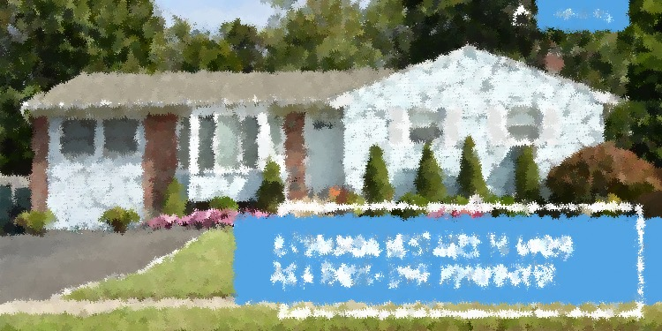
HOMEOWNERSHIP DIVISION
First-time Homebuyer Program
40 Participating Lenders (2.375% + $500 + $250 MCC)
266 branch locations
51% are originated in Sioux Falls or Rapid City
58% of the originated loans come from the top five lenders
5 sub servicers (69% are with Great Western Bank)
1 master servicer - Idaho Housing and Finance Association
FY2019
4,925
7.09%
.45%
$409.5
2,695
8.39%
FY2020
4,279
6.52%
.44%
$444.7
2,731
8.31%
FY2021
3,484
6.63%
.29%
$441.0
2,511
8.40%
Portfolio Size
Delinquency Rate
Foreclosure Rate
Loan Volume (in millions)
New Loans
New Construction

Slide 26
HOMEOWNERSHIP DIVISION
Brent Adney
Director
Oversees all activities of the Homeownership Programs Division

Slide 27
MULTIFAMILY DEVELOPMENT DIVISION
Low Income Housing Tax Credit Program
Created under the Internal Revenue Code of 1986
Provides investors (typically large corporations) dollar for dollar tax credit to offset federal tax liability for a ten-year period
Equity (purchase of the credits) subsidizes the cost of the housing development allowing the rents to be below market and affordable
Units restricted to households at or below 60% AMI

Slide 28
MULTIFAMILY DEVELOPMENT DIVISION
Low Income Housing Tax Credit Program
Qualified Allocation Plan outlines how SDHDA administers the HTC Program – incorporates federal requirements and SDHDA preferences
Funding is competitive and applications are scored and ranked
HTC Program requires a minimum 30-year compliance period
IRS may recapture HTCs during first 15 years for noncompliance

Slide 29
MULTIFAMILY DEVELOPMENT DIVISION
Low Income Housing Tax Credit Program
For FY2020, SDHDA allocated $3,657,817
Applications due the last working day of July
Cumulative since 1987
Over $64.7 million in housing tax credits awarded
Over $919 million in development costs
10,411 housing units constructed or rehabbed

Slide 30
MULTIFAMILY DEVELOPMENT DIVISION
Housing Opportunity Fund
Created via Senate Bill 235 “Building South Dakota Fund” during the 2013 legislative session
Distributed geographically with no more than 30% for Sioux Falls and Rapid City and 70% to other areas
Housing Development – 75%
Programs – 25%
Targeted to serve households at or below 115% AMI

Slide 31
MULTIFAMILY DEVELOPMENT DIVISION
Housing Opportunity Fund
For FY2020, SDHDA allocated $3,400,938
Cumulative since 2013
Over $20 million in Housing Opportunity Funds awarded
Over 2,100 families are expected to benefit

Slide 32
MULTIFAMILY DEVELOPMENT DIVISION
HOME Investments Partnership Program
HOME Program, created in 1992, is funded by the US Department of Housing and Urban Development
HOME loan is subordinated financing at 0% interest with variable repayment terms
HOME funds provided as grant financing for Homeowner Rehabiliation, Security Deposit Assistance, development subsidy, Disaster funds, and Difficult to Develop set-asides

Slide 33
MULTIFAMILY DEVELOPMENT DIVISION
HOME Investments Partnership Program
Eligible projects are new construction, acquisition/rehabilitation or rehabilitation of multifamily and single family homes
Assists households at or below 80% AMI depending upon program
HOME Program Allocation Plan outlines how SDHDA administers the HOME program – incorporates federal requirements and SDHDA preferences

Slide 34
MULTIFAMILY DEVELOPMENT DIVISION
HOME Investments Partnership Program
Funding is competitive and applications are scored and ranked
Compliance period is determined by type of activity and term of the HOME loan

Slide 35
MULTIFAMILY DEVELOPMENT DIVISION
HOME Investments Partnership Program
HOME Set-asides
Community Housing Development Organization (CHDO) – 15% of annual allocation – est. $450,000
Homeowner Rehabilitation Program – $1,000,000
Homebuyer Assistance Program – $200,000
Security Deposit Assistance Program – $200,000
Difficult to Develop Grant – $500,000
Homeownership Development – $500,000
Rural Housing Development - $1,000,000
Declared Disasters (SDAP and Rehab) - $500,000

Slide 36
MULTIFAMILY DEVELOPMENT DIVISION
HOME Investments Partnership Program
For FY2020, reserved $5.7 million in funding
Applications are due the last working day of July
Cumulative since 1992
Just under $132 million in HOME dollars committed
Over $47.4 million of program income
Completion of 5,480 units totaling $560,037,551

Slide 37
MULTIFAMILY DEVELOPMENT DIVISION
Housing Trust Fund (HTF)
Created under Housing and Economic Recovery Act of 2008
Funding from Fannie Mae and Freddie Mac earnings
2016 – First year the program was funded
$3 million annual allocation
Funding targeted to extremely low-income (30% AMI)
Funding available for acquisition, rehabilitation and new construction
Rental housing has a minimum 30 year affordability period

Slide 38
MULTIFAMILY DEVELOPMENT DIVISION
Housing Trust Fund (HTF)
Housing Trust Fund Allocation Plan outlines federal requirements and SDHDA preferences
$600,000 set-aside for housing developed on Indian Reservations and $600,000 for Special Needs Housing
HTF subsidy limits established by bedroom size and location
Funding is competitive and applications are scored and ranked
Applications due the last working day of July

Slide 39
MULTIFAMILY DEVELOPMENT DIVISION
Housing Trust Fund (HTF)
For FY2020, reserved $2.4 million in funding
Applications are due the last working day of July
Cumulative since 2016
Over $12.3 million in HTF dollars committed
Completion of 462 units totaling $69,184,065
91% of HTF funds to new construction, 9% for rehabilitation

Slide 40
MULTIFAMILY DEVELOPMENT DIVISION
Community Housing Development Program
Construction and permanent loans financed with SDHDA reserve funds
Loan term up to 30 years with interest rates based on market
Financing up to 100% for nonprofit owners or 90% for profit owners
Financing for new construction or acquisition and substantial rehabilitation of rental properties

Slide 41
MULTIFAMILY DEVELOPMENT DIVISION
Community Housing Development Program
Loan amount of $250,000 to $5,000,000
Interest rate 3.5% currently
At least 50% of the housing units must be restricted at or below 120% AMI – workforce housing
$17,753,423 committed to date creating or rehabbing 264 units

Slide 42
MULTIFAMILY DEVELOPMENT DIVISION
Multifamily Bond Financing
Permanent and construction loans through the sale of tax-exempt or taxable revenue bonds
Loan term for up to 50 years with interest rate based on market
Financing up to 100% for nonprofit owners or 90% for profit owners, credit enhancements necessary
Financing for new construction or acquisition and substantial rehabiliation of rental properties
Typically for large multifamily developments
1,115,105 tax credits totaling $32,164,500 in equity for 423 units created/rehabbed to date

Slide 43
MULTIFAMILY DEVELOPMENT DIVISION
Housing Needs Study Program
Incentive program to help communities conduct housing needs studies
Communities with populations of 10,000 or less are eligible
SDHDA provide grant funding for up to $5,000 per study – 50% of the cost
Partner with Community Partners Research, Inc. of Faribault, MN
To date, 79 studies approved, $313,000 in funding

Slide 44
MULTIFAMILY DEVELOPMENT DIVISION
Chas Olson
Director – Multifamily Development
Chas@sdhda.org 605-773-4132
Amy Eldridge
Housing Development Officer
amy@sdhda.org 605-773-2467
DeNeil Taylor
Housing Development Officer
deneil@sdhda.org 605-773-4247
Scott Rounds
Housing Development Officer
scott@sdhda.org 605-773-432

Slide 45
SDPA 2021 Annual Conference
Questions?
Mike Harsma
Director, Single Family Development
mike@sdhda.org 605-773-52369

